Slide 1
CST426 - CLIENT SERVER ARCHITECTURE

Slide 2
Module – 3 Client/Server Network
Client
Services
Request for services
RPC
Windows services
Print services
Remote boot services
other remote services
Utility Services
Dynamic Data Exchange (DDE)
Object Linking and Embedding (OLE)
Common Object Request Broker Architecture (CORBA).
Server
Detailed server functionality
Network operating system
Available platforms
Server operating system.

Slide 3
Client Services
Some of the main services that client performs :
Responsible for managing the user interface.
Provides presentation services.
Accepts and checks the syntax of user inputs.
Acts as a consumer of services provided by one or more server processors.
Processes application logic.
The role of the client process can be further extended at the client by adding logic that is not implemented in the host server application.
Local editing, automatic data entry, help capabilities, and other logic processes can be added in front of the existing host server application.
Generates database request and transmits to server.
Passes response back to server.

Slide 4
Some of the other important services that are directly or indirectly attached with the client services are given below:
(a) Inter process communication.
(b) Remote services.
(c) Window services.
(d) Dynamic data exchange.
(e) Object linking and embedding(OLE).
(f) Common object request broker architecture (CORBA).
(g) Print/Fax services.
(h) Database services.

Slide 5
Request for Service
Client workstations request services from the attached server.
Whether this server is the same processor or a network processor, the application format of the request is the same.
Interprocess communication (IPC) is the generic term used to describe communication between running processes.
In the client/server model, these processes might be on the same computer, across the LAN, or across the WAN.

Slide 6
The most basic service provided by the NOS is redirection.
This service intercepts client workstation operating system calls and redirects them to the server operating system.
Requests for disk directories, disk files, printers, printer queues, serial devices, application programs, and named pipes are trapped by the redirection software and redirected (over the LAN) to the correct server location.

Slide 7
It is still possible for some of these services to be provided by the client workstation.
The local disk drives may be labeled A: and C: and the remote drives labeled D:, E:, and F:.
How does redirection work?
Any request for drive A: or C: is passed through to the local file system by the redirection software. Requests for other drives are passed to the server operating system. Printers are accessed through virtual serial and parallel ports defined by the NOS redirector software.
The NOS requester software constructs the remote procedure call (RPC) to include the API call to the NOS server.
The NOS server then processes the request as if it were executed locally and ships the response back to the application.

Slide 8
Remote Procedure Call (RPC)
RPC is a powerful technique for constructing distributed, client-server based applications.
It allows programs on different machines to interact using simple procedure call or return semantics, just as if the two programs were on the same machine.
It is based on extending the notion of local procedure calling, so that the called procedure need not exist in the same address space as the calling procedure.
The two processes may be on the same system, or they may be on different systems with a network connecting them. ie, the procedure call is used to access remote services.

Slide 9
How RPC Works:
An RPC mechanism is analogous to a function call.
Like a function call, when an RPC is made, the calling arguments are passed to the remote procedure and the caller waits for a response to be returned from the remote procedure.
Fig illustrates the general architecture of remote procedure call mechanism that takes place during an RPC call between two networked systems.
The client makes a procedure call that sends a request to the server and waits.
The thread is blocked from processing until either a reply is received, or it times out.
When the request arrives, the server calls a dispatch routine that performs the requested service, and sends the reply to the client.
After the RPC call is completed, the client program continues. RPC specifically supports network applications.

Slide 10
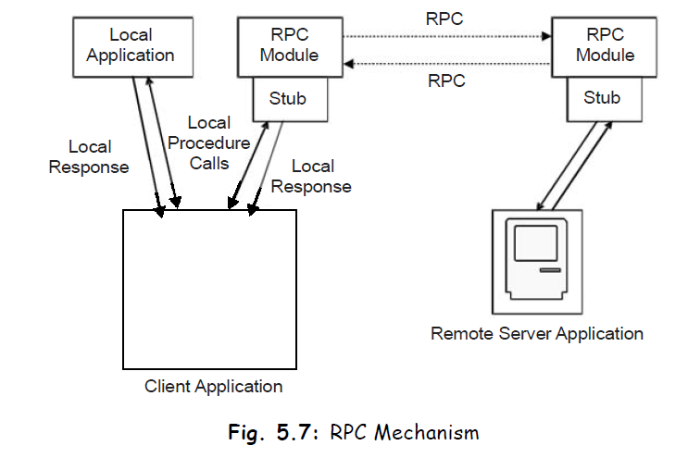

Slide 11
A remote procedure is uniquely identified by the triple: program number, version number, procedure number
The program number identifies a group of related remote procedures, each of which has a unique procedure number.
A program may consist of one or more versions.
Each version consists of a collection of procedures which are available to be called remotely.
Each version contains a number of procedures that can be called remotely.
Each procedure has a procedure number.

Slide 12
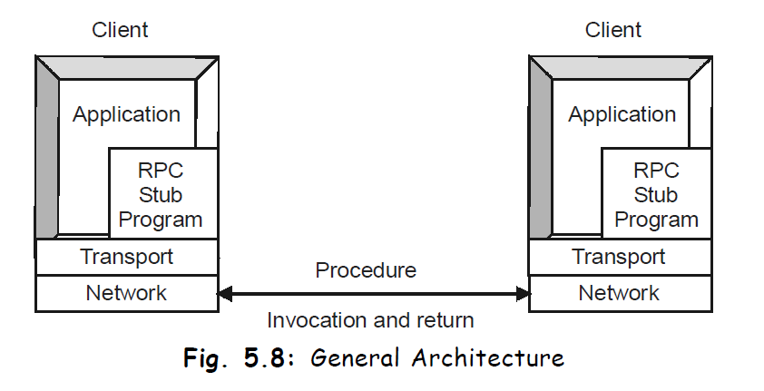

Slide 13
When the client invokes the remote procedure RPC calls the appropriate stub, passes the parameters to it, which are then provided, to remote procedure.
This stub locates the port on the server and marshalling involves packaging the parameter into a form, which may be transmitted over network.
The stub then transmits a message to server using message passing.
Now the message sent by the host is received at the client side with the help of similar type of stub.

Slide 14
Window Services
A client workstation may have several windows open on-screen at any time.
The capability to activate, view, move, size, or hide a particular window is provided by the window services of the client operating system.
These services are essential in a client/server implementation, because they interact with message services provided to notify the user of events that occur on a server.
Application programs are written with no sensitivity to the windowing.
Each application is written with the assumption that it has a virtual screen.
This virtual screen can be an arbitrary size and can even be larger than the physical screen.

Slide 15
The windowing services handle placement and manipulation of the application window.
So there is no need for the developer to build or manage the windowing services.
The client user is totally in control of his or her desktop and can give priority to the most important tasks at hand by positioning the window of interest to the "front and center."
The NOS provides software on the client workstation to manage the creation of pop-up windows that display alerts generated from remote servers.
E-mail receipt, print complete, Fax available, and application termination are examples of alerts that might generate a pop-up window to notify the client user.

Slide 16
Fax/Print Services
The NOS enables the client to generate print requests even when the printer is busy.
These are redirected by the NOS redirector software and managed by the print server queue manager.
The client workstation can view the status of the print queues at any time.
Many print servers notify the client workstation when the print request is completed.
Fax services are made available in exactly the same manner as print servers, with the same requester server interface and notification made available.

Slide 17
Remote Boot Services
Some applications operate well on workstations without any local disk storage; X-terminals and workstations used in secure locations are examples.
The client workstation must provide sufficient software burned into erasable programmable read-only memory (E-PROM) to start the initial program load (IPL)—that is, boot process.
E-PROM is included in all workstations to hold the Basic Input/Output System (BIOS) services.
This mini-operating system is powerful enough to load the remote software that provides the remaining services and applications functions to the client workstation or X-terminal.

Slide 18
Other Remote Services
Applications can be invoked from the client to execute remotely on a server.
Backup services are an example of services that might be remotely invoked from a client workstation.
Business functions such as downloading data from a host or checking a list of stock prices might also be invoked locally to run remotely.
Software is provided by the NOS to run on the client workstation to initiate these remote applications.
Mobile computing is increasingly being used to remain functional while out of the office.
Applications can be built to operate effectively from the office LAN or the remote laptop.
The IPC protocol of choice for mobile access is TCP/IP based.

Slide 19
Utility Services
The operating system provides local functions such as copy, move, edit, compare, and help that execute on the client workstation.

Slide 20
Dynamic Data Exchange (DDE)
DDE is described as a conversation between two applications, a client application and a server application.
It sends messages between applications that share data and uses shared memory to exchange data between applications.
DDE is a feature of some operating systems (like Windows 98, OS/2) presentation manager that enable users to pass data between applications to application.
For eg:, if an application wants to connect a Microsoft Excel spreadsheet with Microsoft Word for windows report in such a way that changes to the spreadsheet are reflected automatically in the report, in that case Microsoft Word for windows is the client and Microsoft Excel is the server.

Slide 21
Uses for Windows Dynamic Data Exchange
DDE is most appropriate for data exchanges that do not require ongoing user interaction.
An application provides a method for the user to establish the link between the applications exchanging data.
Once that link is established, the applications exchange data without further user involvement.
DDE can be used to implement a broad range of application features:
Linking to real-time data, such as to stock market updates, scientific instruments, or process control.
Creating compound documents, such as a word processing document that includes a chart produced by a graphics application. Using DDE, the chart will change when the source data is changed, while the rest of the document remains the same.

Slide 22
Two applications participating in DDE are said to be engaged in a DDE conversation.
The application that initiates the conversation is the DDE client application; the application that responds to the client is the DDE server application.
An application can engage in several conversations at the same time, acting as the client in some and as the server in others.

Slide 23
The DDE protocol identifies the units of data passed between the client and server with a three-level hierarchy of application, topic, and item names.
Each DDE conversation is uniquely defined by the application name and topic.
At the beginning of a DDE conversation, the client and server determine the application name and topic.
The application name is usually the name of the server application. For eg, when Excel acts as the server in a conversation, the application name is Excel.
For applications that operate on file-based documents, the topic is usually a filename.
A DDE data item is information related to the conversation topic exchanged between the applications.

Slide 24
For eg, if the Word document is to receive data automatically from a range named IBM in a Excel worksheet, named STOCKS.XLS then STOCKS.XLS is the topic and IBM is the item.
A simplest way to set up a DDE link is to copy a block of data from the server application to the clipboard, activate the client application, move the insertion point to the location in the receiving document where you want the information to go, and then use a Paste Link command.

Slide 25
Dynamic Data Exchange Message Flow
A typical DDE conversation consists of the following events:
The client application initiates the conversation, and the server application responds.
The applications exchange data by any or all of the following methods:
The server application sends data to the client at the client's request.
The client application sends unsolicited data to the server application.
The client application requests the server application to notify the client whenever a data item changes (warm data link).
The client application requests the server application to send data whenever the data changes (hot data link).
The server application carries out a command at the client's request.
Either the client or server application terminates the conversation.

Slide 26
Once a DDE conversation has begun, the client can establish one or more permanent data links with the server.
There are two kinds of permanent DDE data links: warm and hot.
In a warm data link, the server notifies the client that the value of the data item has changed, but the server does not send the data value to the client until the client requests it.
In a hot data link, the server immediately sends the changed data value to the client.

Slide 27
A DDE link may be automatic or manual.
An automatic link is refreshed whenever the source data changes, provided both the client and server applications are running.
A manual link is refreshed only when you issue a command in the client application.

Slide 28
Object Linking and Embedding (OLE)
OLE is an extension to DDE that enables objects to be created with the object components software aware.
Aware means that a reference to the object or one of its components automatically launches the appropriate software to manipulate the data.
For example, a document created with a word processor may include an image created by a graphics package.
The image can be converted to the internal graphics form of the word processor, such as WPG form for WordPerfect.
With OLE, the image can be included in its original form within the document object; whenever the image is selected or highlighted, the graphics package will take control to manipulate the image.
Activation of the software is totally transparent to the users as they navigate through the document.

Slide 29
Currently with OLE, one software package accesses data created from another through the use of a viewer or launcher.
These viewers and launchers must be custom built for every application.
With the viewer, users can see data from one software package while they are running another package.
Launchers invoke the software package that created the data and thus provide the full functionality of the launched software.

Slide 30
Currently with OLE, one software package accesses data created from another through the use of a viewer or launcher.
These viewers and launchers must be custom built for every application.
With the viewer, users can see data from one software package while they are running another package.
Launchers invoke the software package that created the data and thus provide the full functionality of the launched software.

Slide 31
OLE 2.0 extends OLE capabilities to enable a group of data to be defined as an object and saved into a database.
This object can then be dragged and dropped into other applications and edited without the need to switch back to the application which created it.
This provides a more seamless interface for the user.

Slide 32
DDE and OLE provide a substantial advantage: any DDE- or OLE-enabled application can use any software that supports these data interchange APIs.
An e-mail application will be able to attach any number of components into the mail object without the need to provide custom viewers or launchers.

Slide 33
Not all Windows applications support OLE, but Microsoft has released its OLE 2.0 software development kit (SDK).
The toolkit greatly simplifies OLE integration into third-party, developed applications.
Organizations wanting to create a consistent desktop are beginning to use the OLE SDK as part of custom applications.

Slide 34
In OLE 1.x, double-clicking a Lotus 1-2-3 for Windows spreadsheet embedded in a Microsoft Word for Windows document launches 1-2-3 and opens the document in a 1-2-3 window.
Under OLE 2.0, the active window (Word's) menu and toolbar change to that of 1-2-3.
The user deals only with the object, with no need to be aware of the multiple software being loaded.

Slide 35
Common Object Request Broker Architecture (CORBA)
CORBA is a standard defined by the OMG (Object Management Group). It describes an architecture, interfaces, and protocols that distributed objects can use to interact with each other.
OLE focuses on data sharing between applications on a single desktop.
CORBA addresses cross-platform data transfer and the process of moving objects over networks.
CORBA support enables Windows and UNIX clients to share objects.
Eg: A word processor operating on a Windows desktop can include graphics generated from a UNIX workstation.

Slide 36
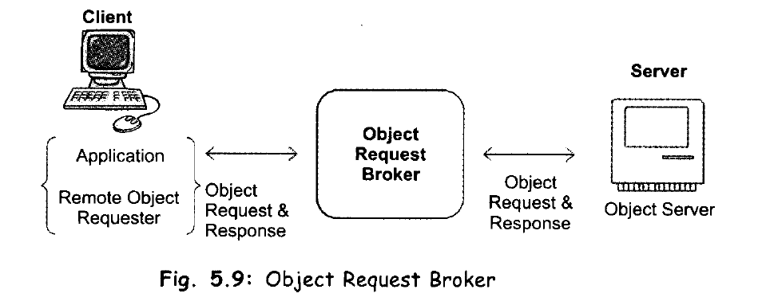
CORBA – Common Object Request Broker

Slide 37
CORBA is a standard for distributing objects across networks so that operations on those objects can be called remotely.
CORBA is not associated with a particular programming language, and any language with a CORBA binding can be used to call and implement CORBA objects.
Part of the CORBA standard is the Interface Definition Language (IDL), which is an implementation-independent language for describing the interfaces of remote objects.

Slide 38
CORBA includes the following components:
Object Request Broker (ORB) : responsible for all interactions between remote objects and the applications that use them. ORB handles the communication, marshaling, and unmarshaling of parameters so that the parameter handling is transparent for a CORBA server and client applications.
CORBA server : The CORBA server creates CORBA objects and initializes them with an ORB. The server places references to the CORBA objects inside a naming service so that clients can access them.
CORBA Request node : The CORBARequest node acts as a CORBA client.

Slide 39
Naming service : The naming service holds references to CORBA objects.
Interface Definition Language (IDL) : which is how CORBA interfaces are defined.
Portable Object Adaptor (POA): is responsible for object activation/deactivation, mapping object ids to actual object implementations.
Internet Inter-ORB Protocol (IIOP) : CORBA objects communicate with each other over the Internet via the IIOP, which is TCP-based but uses no fixed port number.

Slide 40
Fig: A one-method distributed object shared between a CORBA client and server.
Any relationship between distributed objects has two sides: the client and the server.
The server provides a remote interface, and the client calls a remote interface.

Slide 41
Between the ORBs, communication proceeds by means of a shared protocol, IIOP-the Internet Inter-ORB Protocol.
IIOP, which is based on the standard TCP/IP internet protocol and works across the Internet.
It defines how CORBA-compliant ORBs pass information back and forth.
Like CORBA and IDL, the IIOP standard is defined by OMG, the Object Management Group.
IIOP allows clients using a CORBA product from one vendor to communicate with objects using a CORBA product from another vendor thus permitting interoperability, which is one of the goals of the CORBA standard.

Slide 42
CORBA-compliant ORBs provides a number of optional services like –
looking up objects by name
maintaining persistent objects
supporting transaction processing
enabling messaging
many other abilities useful in today's distributed, multi-tiered computing environments.

Slide 43
Interface Definition Language (IDL)
The services that an object provides are given by its interface.
Interfaces are defined in OMG's Interface Definition Language (IDL).
IDL is independent of any programming language.
Mappings from IDL to specific programming languages are defined as part of the CORBA specification.
Mappings for C, C++, Smalltalk, Ada, COBOL, and Java have been approved by OMG.
In IDL, you declare only the names and types for interfaces, data members, methods, method arguments etc.
You do not include the method implementations.

Slide 44
The method implementations are created in implementation language you choose after you’ve used an IDL compiler (idlj is the IDL compiler for Java) to convert your IDL interface to your target language.

Slide 45
Object Request Broker (ORB)
The core of the CORBA architecture is the ORB.
Each machine involved in a CORBA application must have an ORB running in order for processes on that machine to interact with CORBA objects running in remote processes.
Object clients and servers make requests through their ORBs and the remote ORB locates the appropriate object and passes back the object reference to the requestor.
The ORB provides the communication infrastructure needed to identify and locate objects, handles connection management, etc.
The ORBs communicate with each other via the IIOP.

Slide 46
Naming Service
Defines how CORBA objects can be looked up by a name. It is a Common Object Service (COS) and allows an object to be published using a symbolic name and allows clients to obtain references to the object using a standard API.
The CORBA naming service provides a naming structure for remote objects.
IIOP
The CORBA standard includes specifications for inter-ORB communication protocols that transmit object requests between various ORBs running on the network.

Slide 47
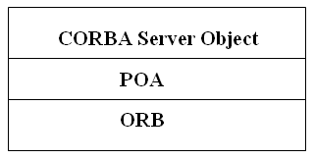
Portable Object Adaptor (POA)
The POA connects the server object implementation to the ORB. It extends the functionality of the ORB and some its services include:
activation and deactivation of the object implementations
generation and management of object references
mapping of object references to their implementations
dispatching of client requests to server objects through a skeleton

